Slide 1
Axicons and Nanowires
By Daniel Todd
Co-Authors: Joshua Nelson, Adam Summers, Dr. Carlos Trallero and Dr. Bret Flanders

Slide 2
Axicon Project
Increase efficiency of power transmission through a hollow core fiber
Propagation through fiber reduces output power
Initially create Bessel beam using Axicon lens
Objectives:
Generate Bessel beam with Axicon
Propagate Bessel beam through hollow core fiber
Characterize the Bessel beam by fitting a spatial mode

Slide 3
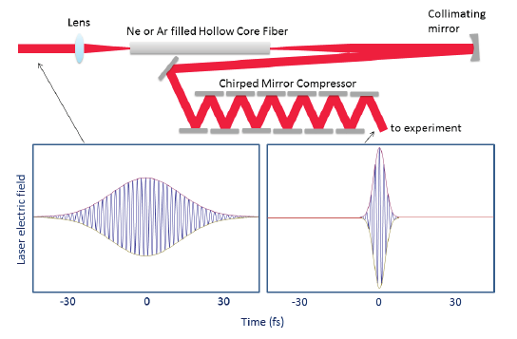
Motivation
Propagation through gas and fiber reduces initial pulse duration
Initial Gaussian converted into short, few-cycle Bessel beam, losing power
Hope to reduce loss by initially producing a Bessel beam
Figure: Kling, N. Controlling the dynamics of electrons and nuclei in ultrafast strong laser fields (Doctoral dissertation)
Notes:
To generate high-intensity, few-cycle pulses we need a fiber
The fiber has special Bessel modes
We want to reduce loss by initially making a Bessel beam

Slide 4
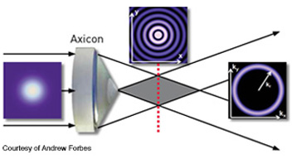
Representation of the Axicon and Bessel beam.
  Incoming Gaussian, near-field Bessel and far-field Bessel.
Center mode intensity drops, leaving characteristic ring

Slide 5
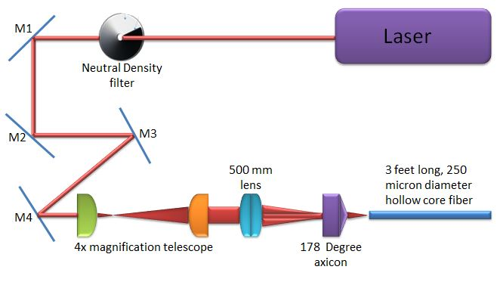
Axicon Experimental Setup
HeNe Laser
250μm, 1 m long Hollow Core Fiber
178˚ Axicon

Slide 6
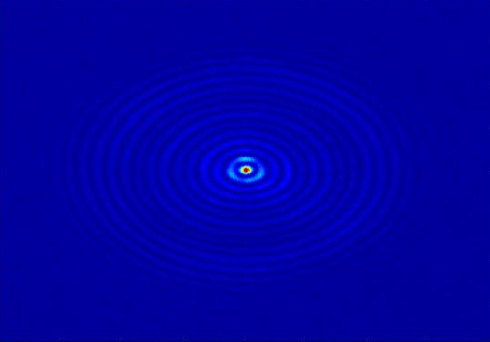
190mm from Axicon
Notes:
Odd shape due to imperfections in the Axicon or imperfections in the fiber

Slide 7


Fitting the Image
We produced MATLAB code that deconstructed an image (S) into a series of Bessel functions
Differing orders n (J_{n}) and associated coefficients (c_{nm} ).

Slide 8
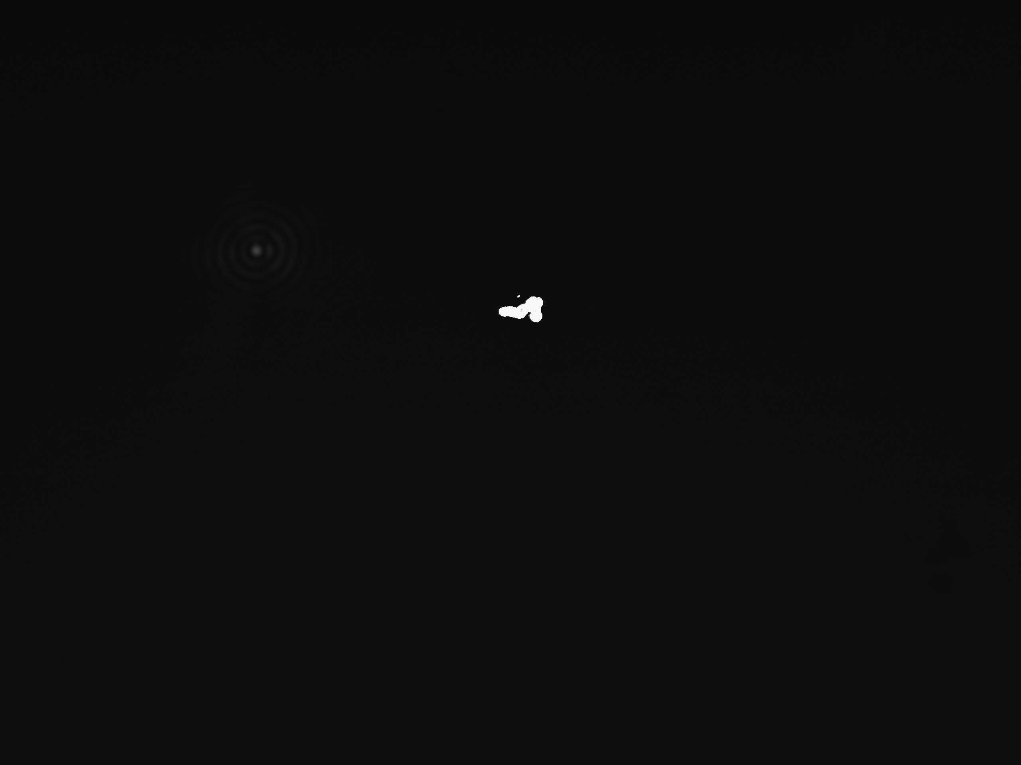
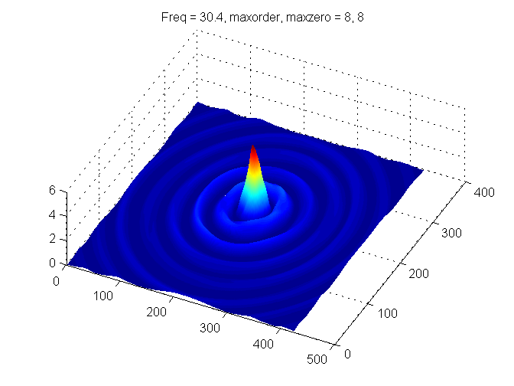
Detailed 3-D plot of intensity of Bessel beam against radial distance from center
Used up to eight orders and eight zero's for each order.
The frequency or parameter p in the equation was found to be 30.4 pixels.
Original Image
Fitted Image

Slide 9
Axicon Results
Attempting to couple into multiple hollow core fibers
Initial power of HeNe: 3.72 mW
*This fiber was 39.5 in and a different brand than compared to all other fibers which were 48 in long. Not much is known about the quality of the 300-500μm fibers, so the data may not represent an accurate finding.
**This measurement was taken without the axicon, using only the lens and 250μm fiber. The efficiency is calculated from an initial power of 4.03mW since no energy was lost by reflections of the axicon.
Inner Diameter (μm) | Transmitted Power (mW) | Efficiency (%)
250* | 2.08 | 55.9
300 | 0.36 | 9.7
350 | 0.78 | 21.0
400 | 0.77 | 20.7
450 | 0.48 | 12.9
500 | 0.40 | 10.8
Lens** | 2.32 | 57.6

Slide 10
Nanowire Project
Summers et al¹ initial experiment suggests that single-crystalline gold nanowires are damaged at very high intensities.
Expand initial experiment to study the effects on damage threshold of:
  Polarization
  Wavelength
  Pulse duration
  Other metals
Requires the fabrication of single-crystalline gold nanowires
¹Summers, A. et al. (2014). Optics express, 22(4), 4235-4246.

Slide 11
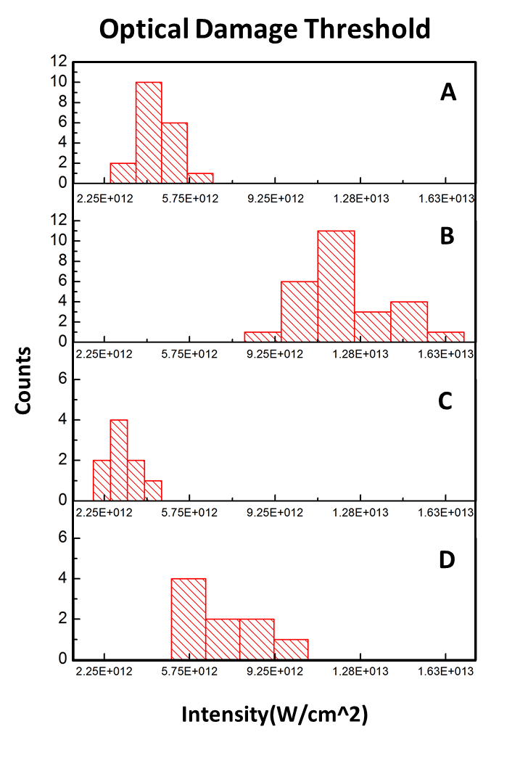
Nanowire Results
108 fs – On Substrate
Adam Summers’ previous research into nanowire damage thresholds used tungsten wire or silica substrate bases.
Damaging intensities for nanowires on tungsten/silica electrodes.
Damage threshold higher for 32 fs than 108 fs pulses.
  2.4 ± 0.7 times higher for nanowires on tungsten
  2.7 ± 0.6 times higher for nanowires on glass
108 fs – On Substrate
32 fs – On Substrate
32 fs – On Substrate
108 fs – On Tungsten
108 fs – On Tungsten
32 fs – On Tungsten
32 fs – On Tungsten
Notes:
The takeaway is that these nanowires are damaged at incredibly high intensities and we want to expand the study to include polarization

Slide 12
Nanowire Objectives
Grow gold (Au) nanowires on glass slides
Study damage threshold of Au nanowires
  Long wavelength and few-cycle pulses
Control polarization of electric field relative to crystal axis

Slide 13
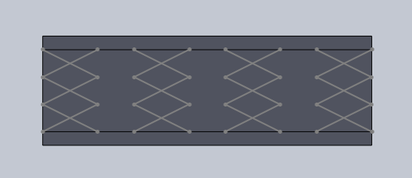
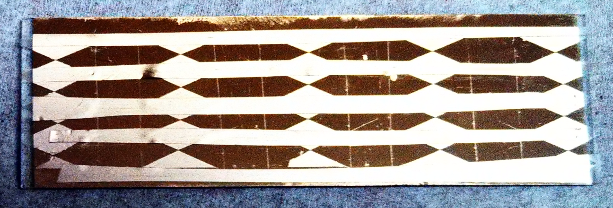
Slide Fabrication
Produced multiple gold (Au) electrodes on glass
Made with Solidworks CAD software
Final design provided up to 2o electrode gaps (100 μm average)

Slide 14
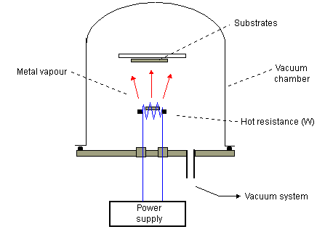
Electrode Production
Placed tape on methanol-cleaned slides
Sliced tape along lines, removed pieces
Evaporated Chromium, then Gold onto slides
  Used a Varian VE-10 Evaporator
Removed remaining tape to reveal electrode gaps

Slide 15
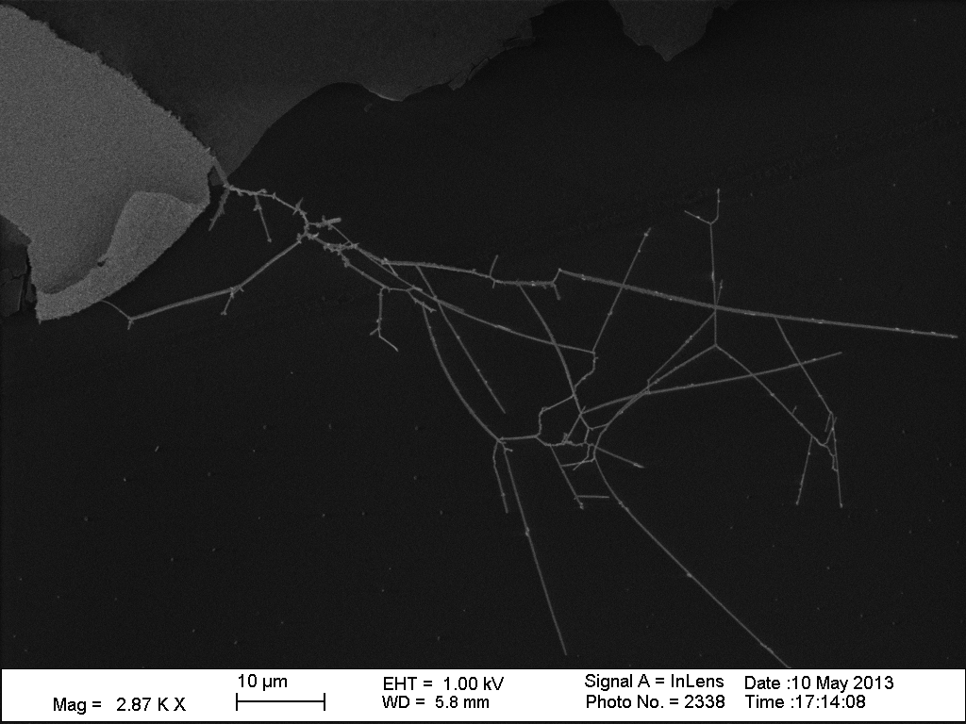
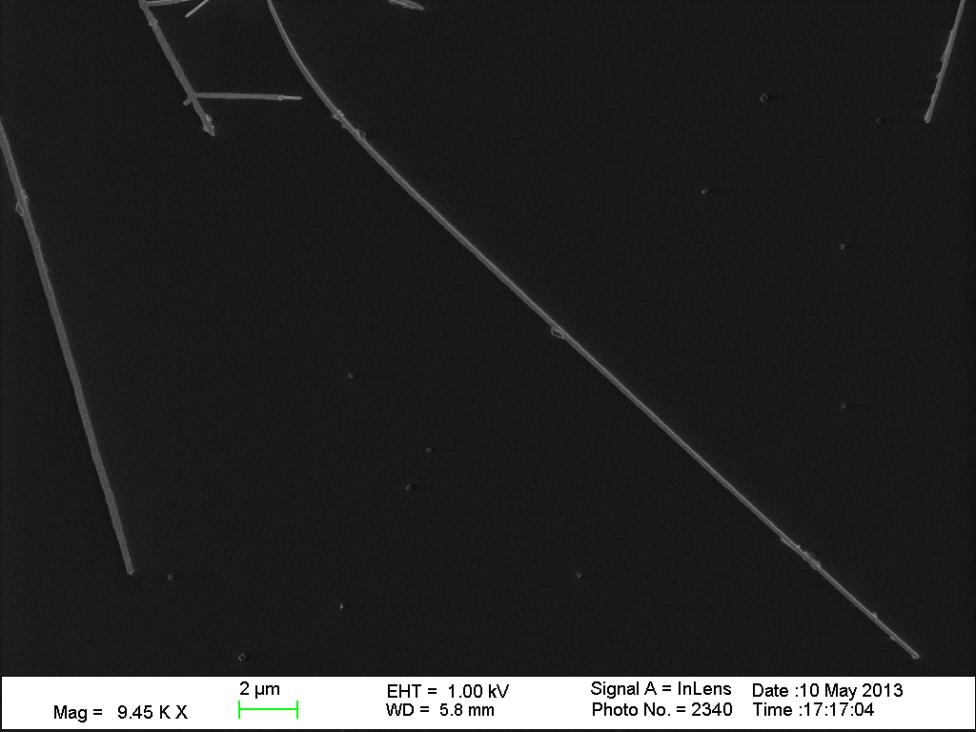
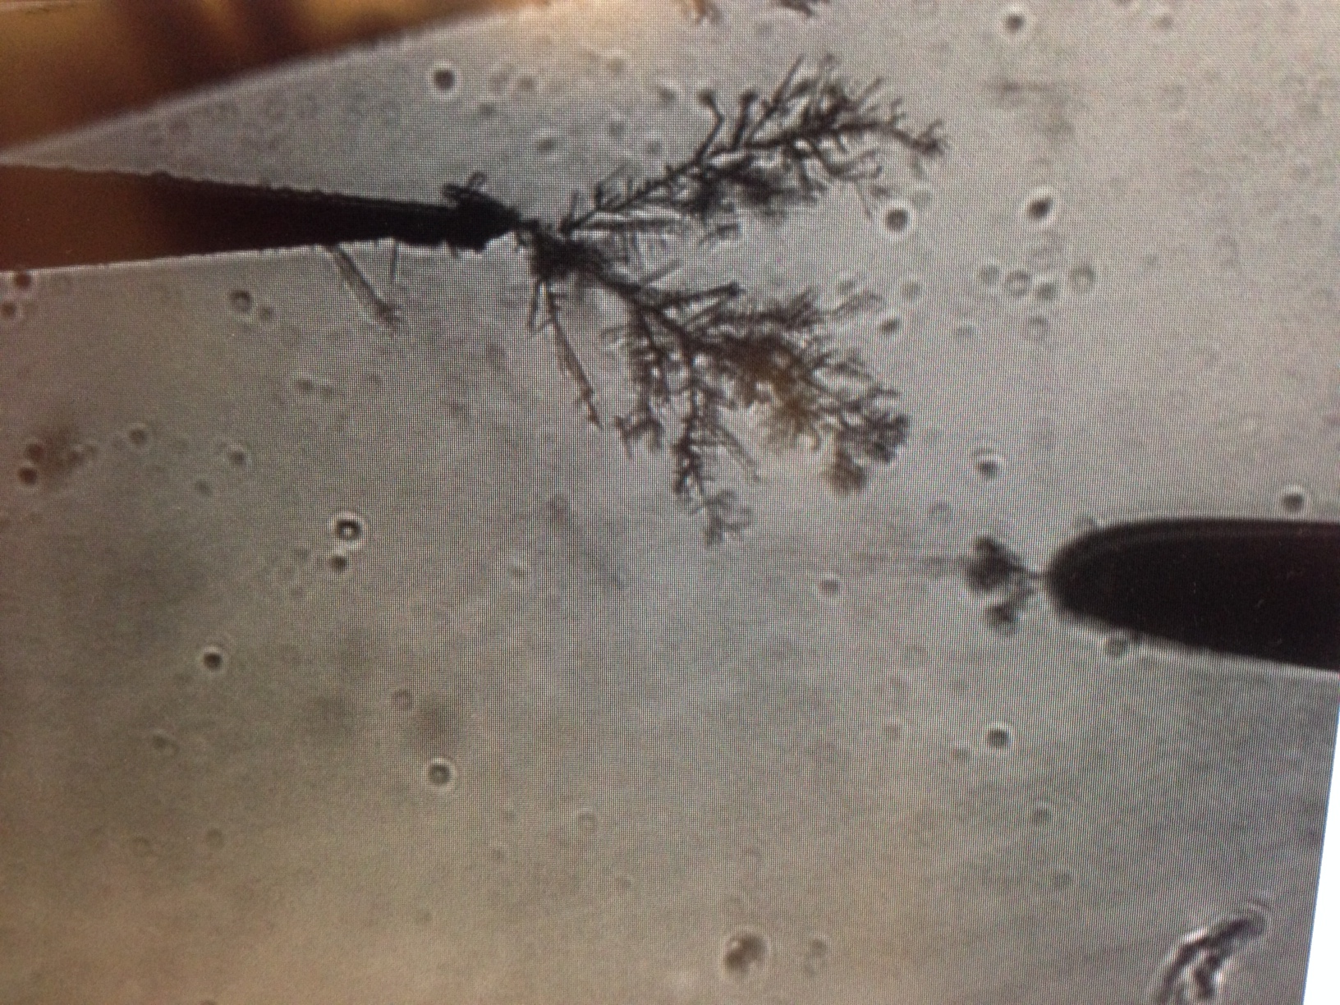
Growing Nanowires
Ideal product: single-crystalline Au nanowires
Group of nanowires (left) and single nanowire (right)
Experimental Product: dense branches of nanowires, not likely single-crystalline
10μm
2μm
Notes:
Electric potential draws in gold particles since it is stronger at the tip, forms nanowires

Slide 16
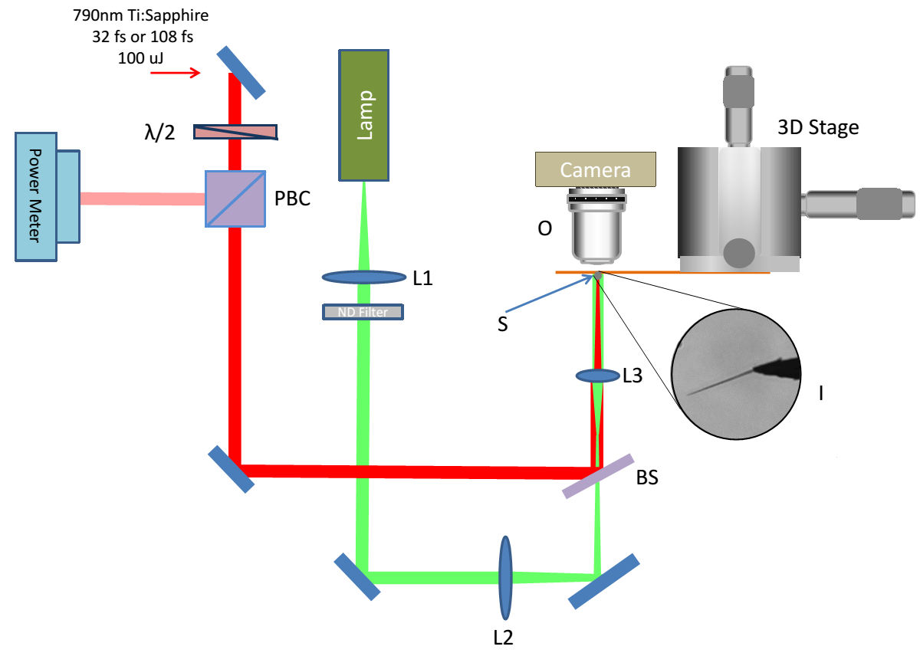
Nanowire Experimental Setup
Notes:
Note the extra half-wave plate for polarization control

Slide 17
Conclusion
Axicon Project:
Successfully generated a Bessel beam and coupled into many hollow core fibers.
Completely characterized Bessel beam by analyzing 2D slices and fitting slices to our equations by varying coefficient values.
Not able to show an increase in the transmission efficiency (but we got close).
Nanowire Project:
Made a useful design for making electrodes on slides and produced about one dozen slides.
Not able to produce many high-quality gold nanowires.
Not able to take any data varying polarization, wavelength and pulse duration.

Slide 18
Acknowledgements
This research was supported and funded by the Department of Basic Energy Science of the Department of Energy (DOE) as well as the National Science Foundation (NSF) grant PHY-1157044 at Kansas State University.
Thank you to those who helped me with these projects: Joshua Nelson, Adam Summers, Dr. Carlos Trallero, Xiaoming Ren, Stefan Zigo and Dr. Bret Flanders.
References:
Summers, A. M., Ramm, A. S., Paneru, G., Kling, M. F., Flanders, B. N., & Trallero-Herrero, C. A. (2014). Optical damage threshold of Au nanowires in strong femtosecond laser fields. Optics express, 22(4), 4235-4246.
Kling, N. Controlling the dynamics of electrons and nuclei in ultrafast strong laser fields (Doctoral dissertation) Retrieved from K-State Research Exchange. <http://hdl.handle.net/2097/16821>
Axicon Image: http://www.osa-opn.org/opn/media/Images/Articles/2013/1306/Features/Forbes-img6.jpg

