Slide 1
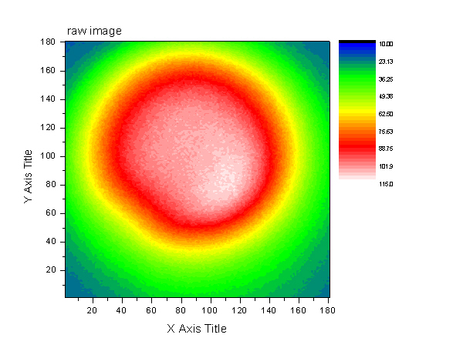
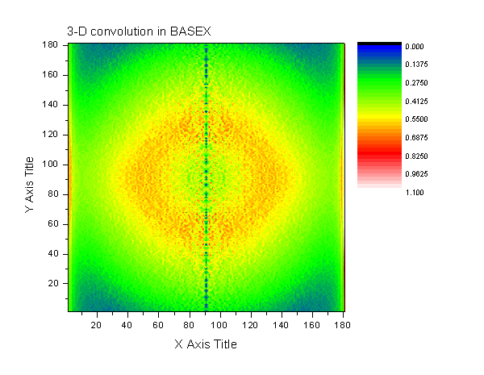
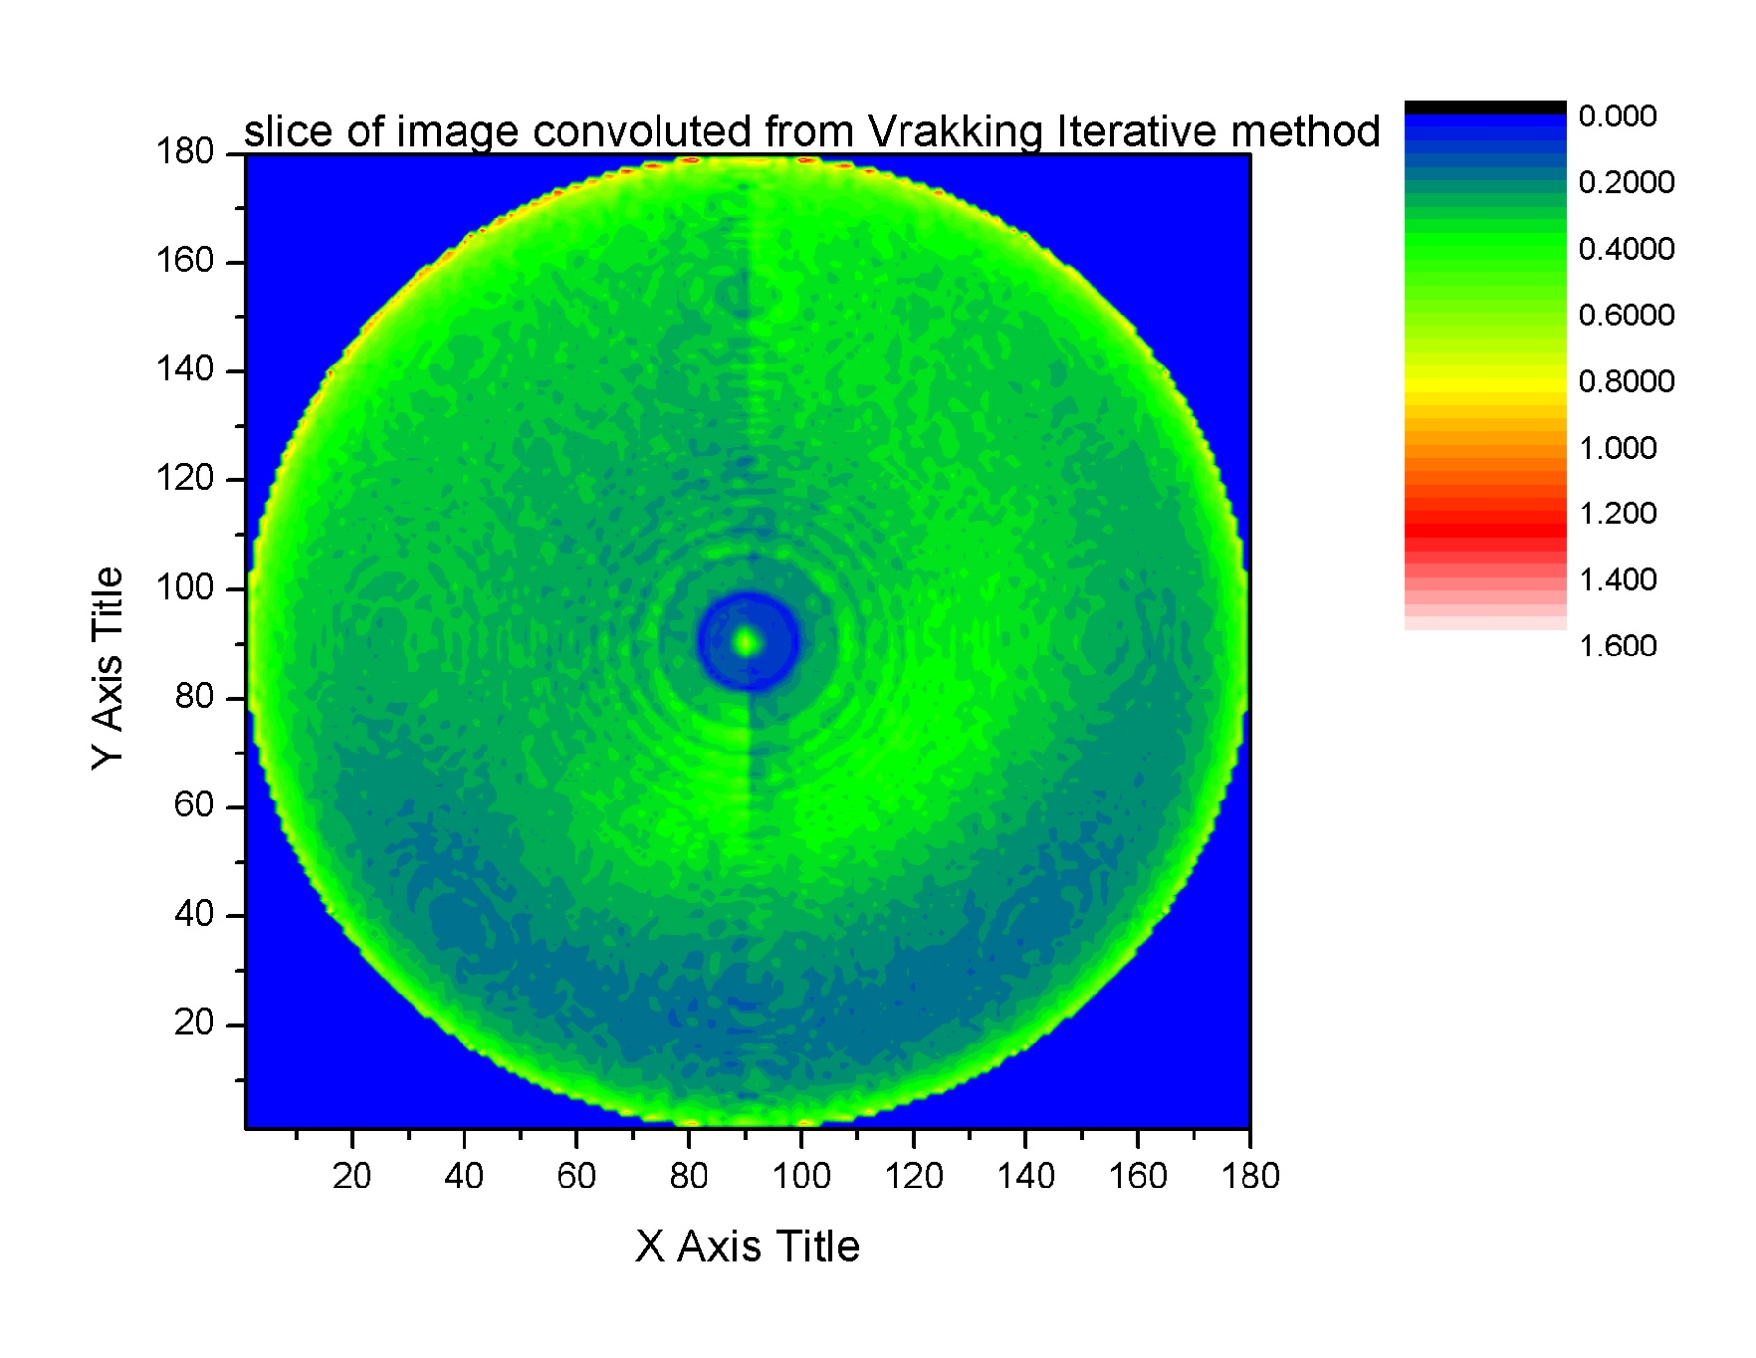
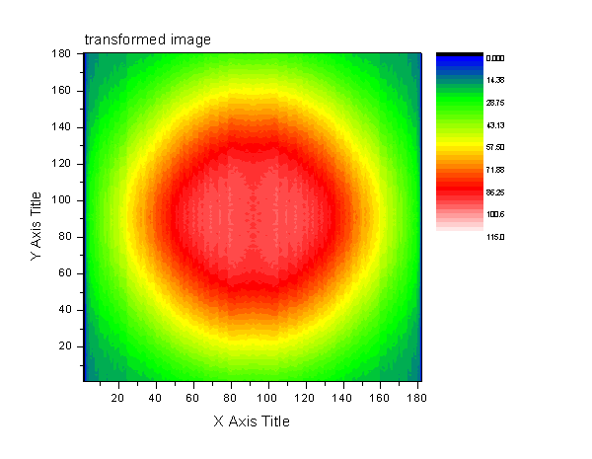
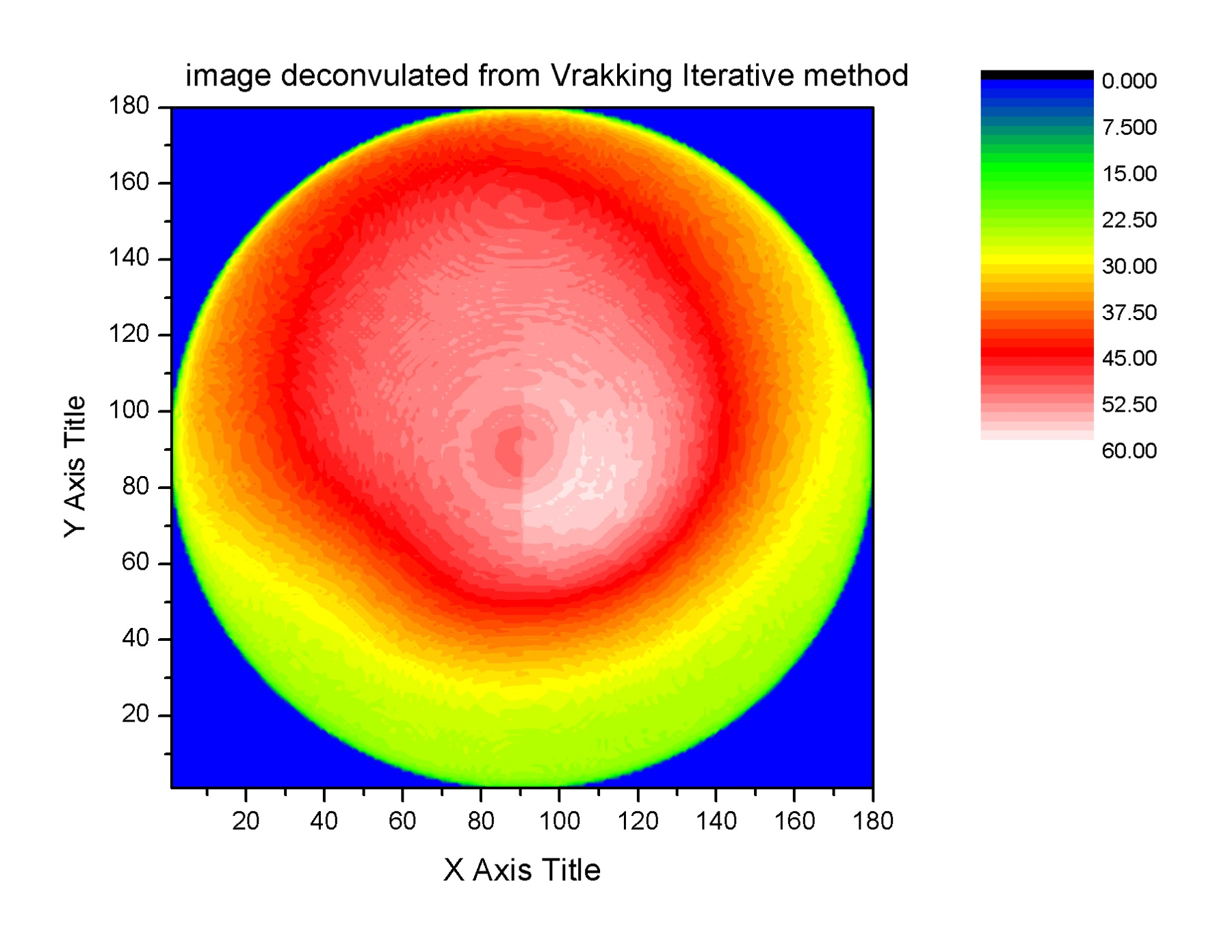
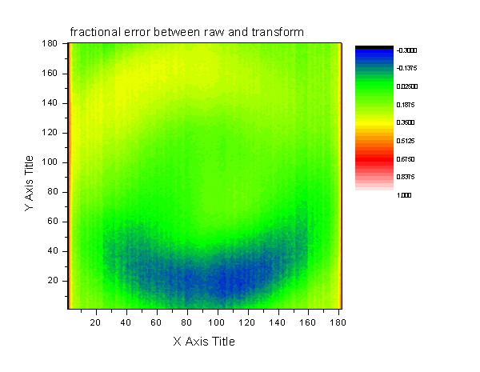
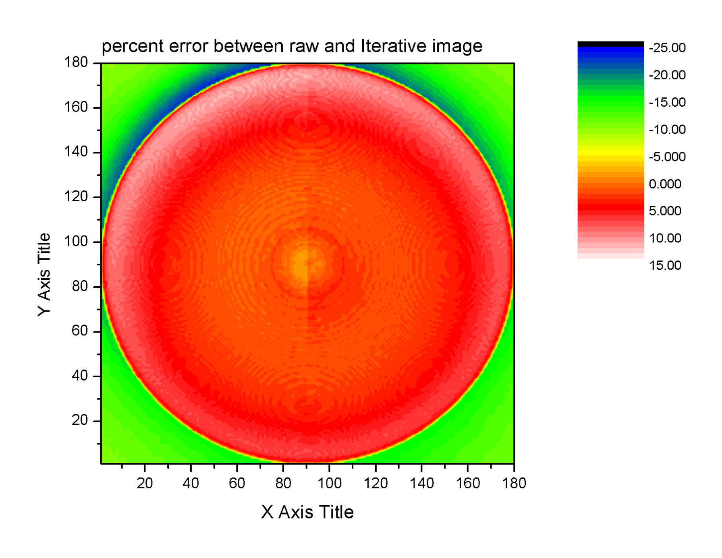
Measuring the Density of Laser-Cooled Atoms
Cameron Cook, Larry Weaver, Brett DePaola
116 Cardwell Hall, Department of Physics, Kansas State University, Manhattan, KS, 66506-2604, USA
Motivation: Coherent excitation in cold collision processes depends delicately on the density of the atomic objective. The density of atoms cooled and trapped in a MOT (magneto optical trap) typically depends on position in the chamber. The goal is to find a method that will measure this density quickly, accurately, and in a fashion that is reproducible.
Camera Calibration
Spatial : At a distance of 7 cm from the viewing port, the camera measures about 85 pixels per mm.
Intensity: By relating the power of a calibration laser to observed pixel value, the relationship follows:
where P is laser power as measured by a power meter, N is the attenuation of a neutral density filter (ND3.0), S is the shutter speed fixed by the user, C is the sum total pixel count of the entire image, k is a constant defined below, and F(G) is the gain function of the camera.
There was a linear relationship between the shutter speed on the camera and the pixel count measured on the computer.
The camera’s gain function was measured to be exponential in the gain value set by the user. This equation is:
Comparison of Abel Transformations performed in BASEX and Iterative Method
-Raw image obtained from CCD camera. Graph of trapped atom
fluorescence, integrated along
viewing axis.
-Two programs, BASEX (left) and Vrakking iterative method (right), that use inverse Abel transform to invert the image into a 3-D density distribution.
-The transformed images are then
deconstructed, allowing a comparison with the raw image.
-Through more code, the 2-D images are each compared, pixel by pixel, to the raw image. A fractional error graph is then produced.
Results
For F(G), several computer images were compared in intensity for specific gain values. After plotting
pixel count and gain, the exponential curve shown above was observed. The following parameters
were determined: with an error of:
For a gain of 603, this gives F(G) = 558.64 and a propagated error, ΔF(G)=169.73. Solving
for k when laser power is 77.4 nW (±2nW), shutter speed is set at 40, sum total pixel count is
1361276, and a measured camera lens attenuation of 8.13%, we obtain k = 1.16 counts per
nW. The propagated error is dependent on the error in power and F(G); so Δk = 0.35 counts
per nW. The fractional error, , equals 0.30.
Knowing this, one may determine the intensity of spontaneous emission in photons per second that
the camera detects. Using the lifetime of the upper state, = 26.63 ns , and the solid angle of the
camera, at a distance r from the MOT, one may determine the number of excited
Atoms that the camera senses using ,
where C’ is the pixel count from the transform images.
Acknowledgements
We would like to thank Bachana Lomsadze, Hyounguk Jang, and Vince Needham for their technical support and expertise.
[1] H. J. Metcalf et al, Laser Cooling and Trapping (1999)
Funding: AFOSR FA9950-08-1-0020
NSF ECS-0449295

