Slide 1
Measuring the Density of Atoms in a Magneto-Optical Trap
Cameron Cook
Advisors: Dr. Brett DePaola
Dr. Larry Weaver
Kansas State University REU 2010

Slide 2
The Goal
Become familiar with the MOT(magneto optical trap) lab
Find a method that will measure the MOT’s atomic density quickly, accurately, and in a manner that is easily reproducible
Calibrate digital CCD camera to laser intensity
Why do we want to know density?
Notes:
Want to know density because if there is a high density in the MOT, then the constant bumping of atoms deters coherent excitation. If we know the density, we can tweak the MOT to have a lower density, to have more excitation processes.

Slide 3
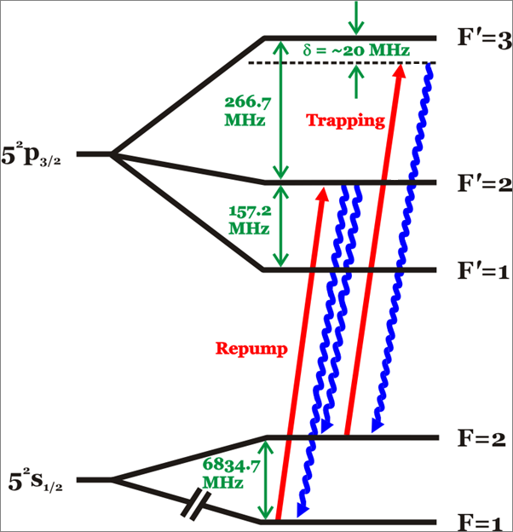
⁸⁷Rb Hyperfine Structure
Nuclear spin, I=3/2
Notes:
This is Rb’s hyperfine structure. Red lines=laser transitions. Blue is spontaneous decay. There are two lasers in our setup, the trap and repump. Trap laser excites the atoms into the 5p state, where the excited atoms have a lifetime of 26.63ns. There is a very small (1/1000) chance that the trap will excite the atom into the F’=2 state. In that case, the atom has 50/50 chance to decay to either the F=2, where it’ll then be excited again by the trap laser, or decay down to F=1. Without the repump laser, eventually all the atoms would decay to F=1 and there’d be no MOT. The repump’s job is to excite them back to F’=2 where it all starts over again. The repump laser can’t excite the atoms to the F’=3. Due to the hyperfine structure, going from F=1 to F=3 would be a change of 2 in angular momentum; a single photon can’t supply this energy.

Slide 4
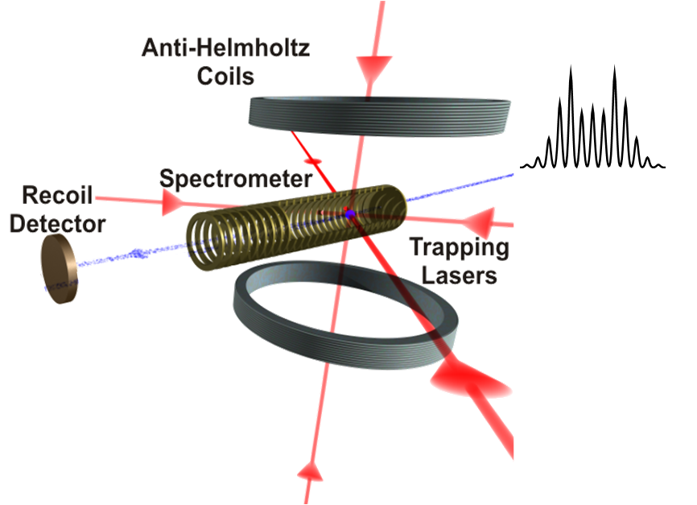
What is a magneto-optical trap?
Need active
medium = ⁸⁷Rb
Optical=2 lasers
Magneto =
2 Anti-Hemholtz coils
Temperature=150µK
Chamber pressure=10⁻¹¹ Torr
Approx. Density 10¹⁰ atoms/cm³
Notes:
This is a rough diagram of the MOT setup. We use Rb87 because it’s an alkali, its wavelength matched the inexpensive laser that we already had, so stick with it. Lasers are combined and split into three counter-propagating beams before the MOT. Laser hitting each axis, ensuring doppler cooling. A Detuned laser coming from two directions does a doppler cooling. Lasers put a damping force opposite the velocity of atom so it cools it. A magnetic field that is zero in the center. Whenever an atom strays from the center the B field pushes atoms back to the center where there is zero field.

Slide 5
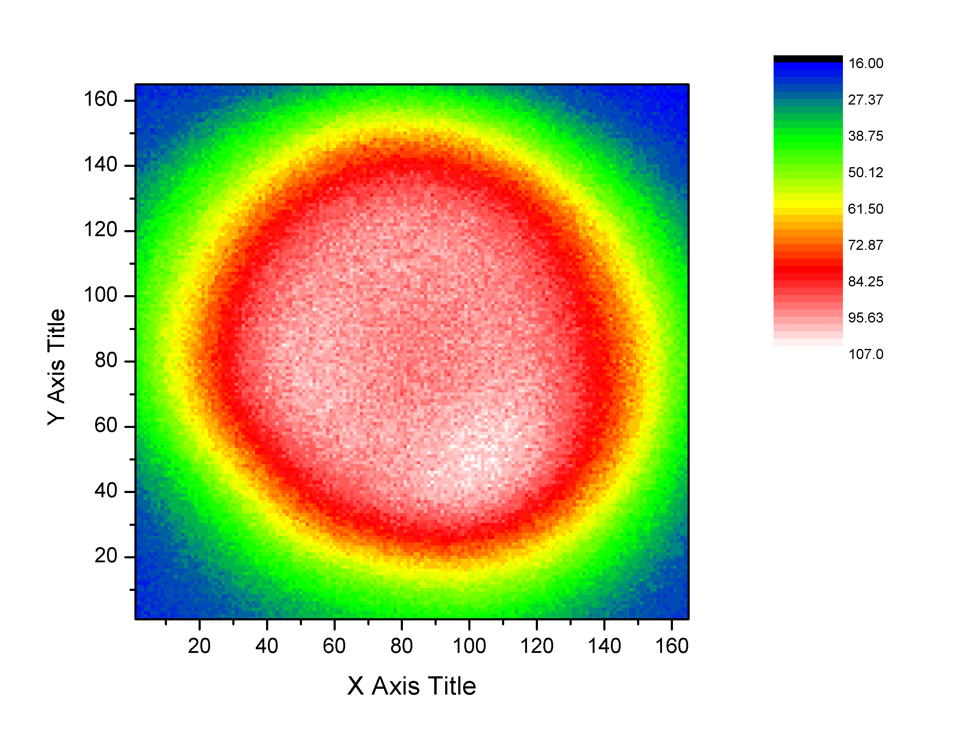
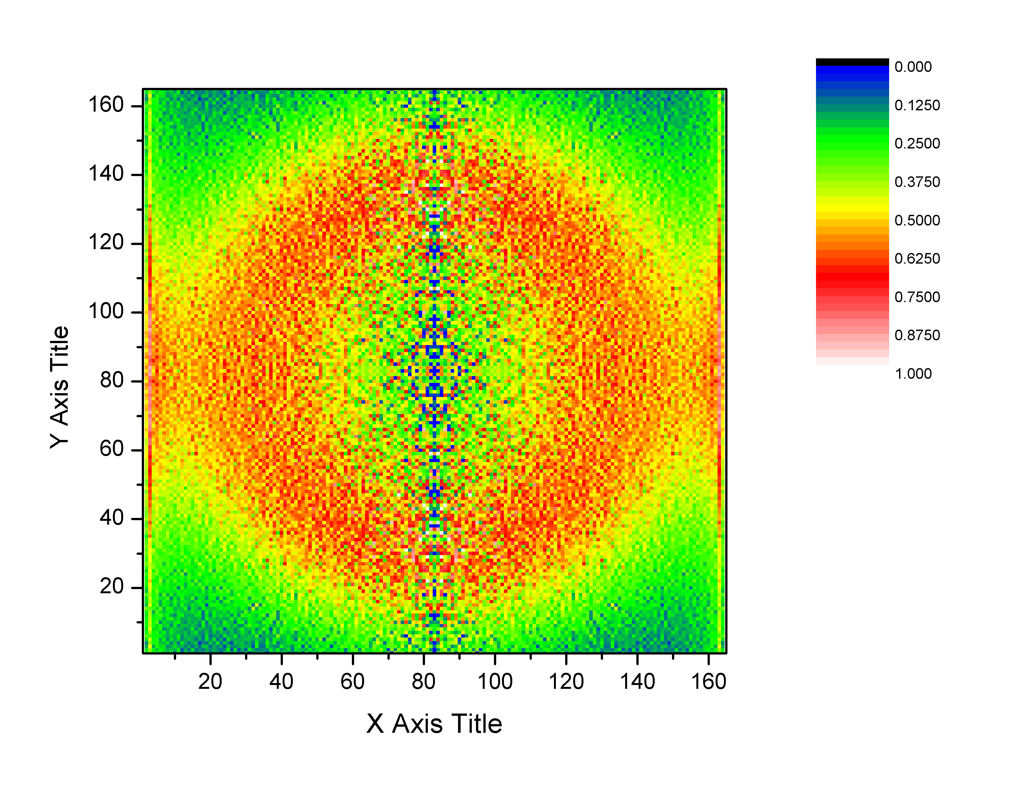
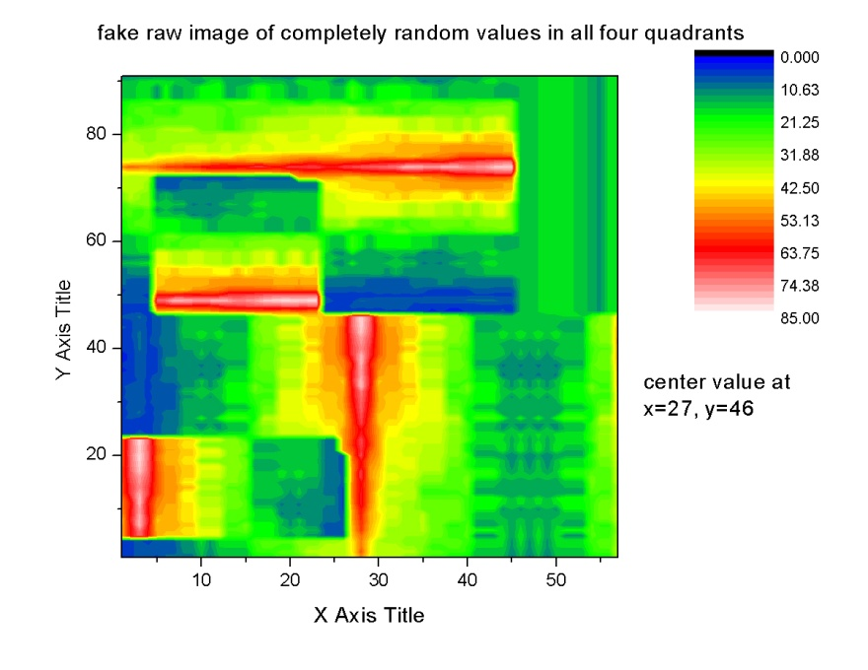
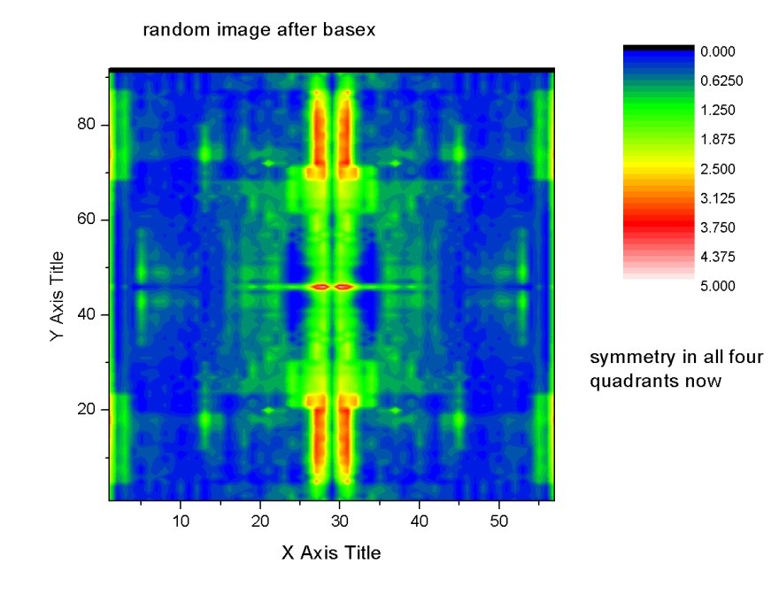
BASEX inversion
Camera image
Test image
BASEX (BAsis Set EXpansion) forces axis of symmetry from raw to inversion
Notes:
When looking through the viewing port, one sees only a portion of an integrated image of fluorescence. The MOT is full of several atoms and each one is capable to flouresce, looking from the outside we see atoms on top of atoms emitting and absorbing. Because we only see one side of a projection of the atoms, We need a program that will use camera pictures to make a density plot. A density plot takes into account all the fluorescence we can’t distinguish. BASEX uses the inverse Abel transform to pull the 2-D projection from the raw camera image into a 3-D density distribution. BASEX inverts line by line so you can see that it produces centerline noise in the middle, also the left and right side are very symmetrical. After seeing this I was skeptical. To see if BASEX was really assuming symmetry on the matrix, I created a completely random matrix with no possible symmetry. As you can see, BASEX created an inverted plot that had symmetrical quadrants, so I saw that an asymmetrical image wouldn’t be very accurate after BASEX. It seems that BASEX superimposes many symmetries on the image.

Slide 6
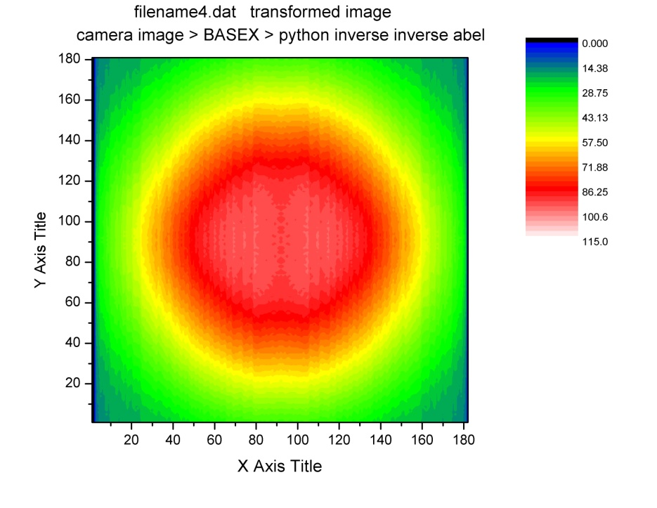
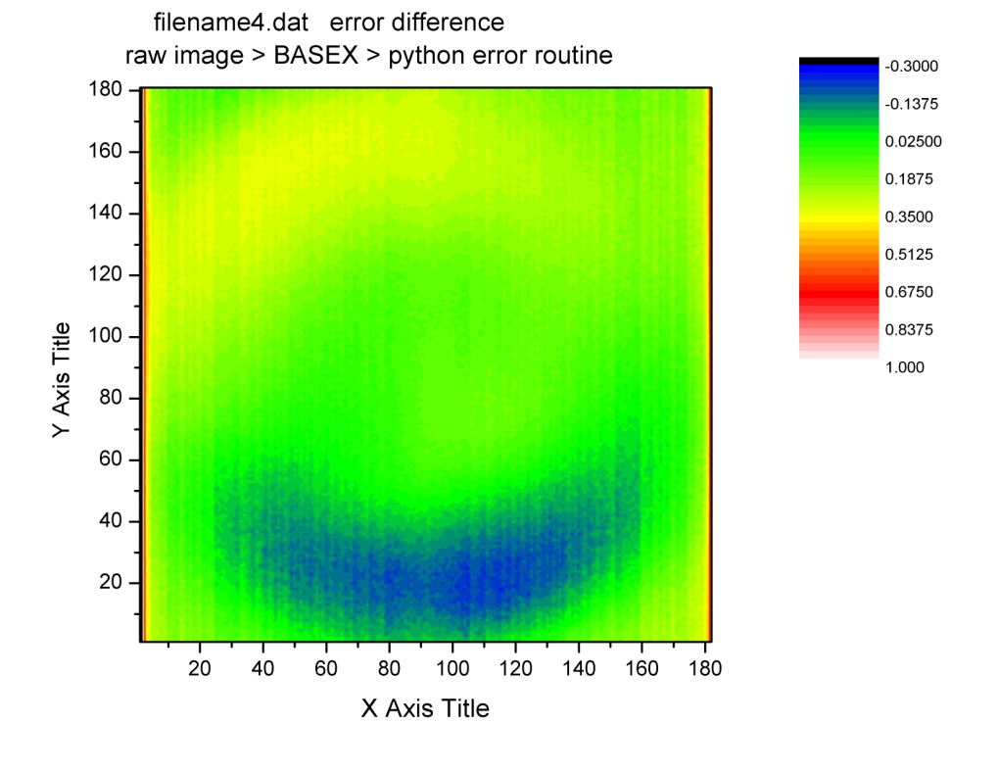
BASEX accuracy
Induced an Abel transform on BASEX’S inversion
Result is deconstructed 2-D plot
Error ranges from
2% - 35%
Notes:
After creating the camera picture’s 3-D density distribution in BASEX, I used a homemade Python code that utilized the Abel transform to deconstruct the 3-D distribution back into a 2-d plot of intensity as a function of position. The code makes use of BASEX’s symmetry so the resulting matrix is also symmetrical. The code takes the radial distance from 3d and plots it back to 2d. You can see symmetry in 2d. Then I compared the deconstructed image to the raw image in the error graph above. The error matrix is then taken by subtracting the raw from the deconstructed image and then divide by deconstruct value. The percent error that results ranges from 30% (from eye of intensity)to 2% to 35%(because top half doesn’t have an eye)

Slide 7
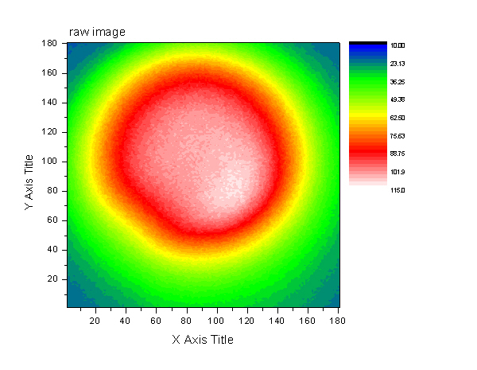
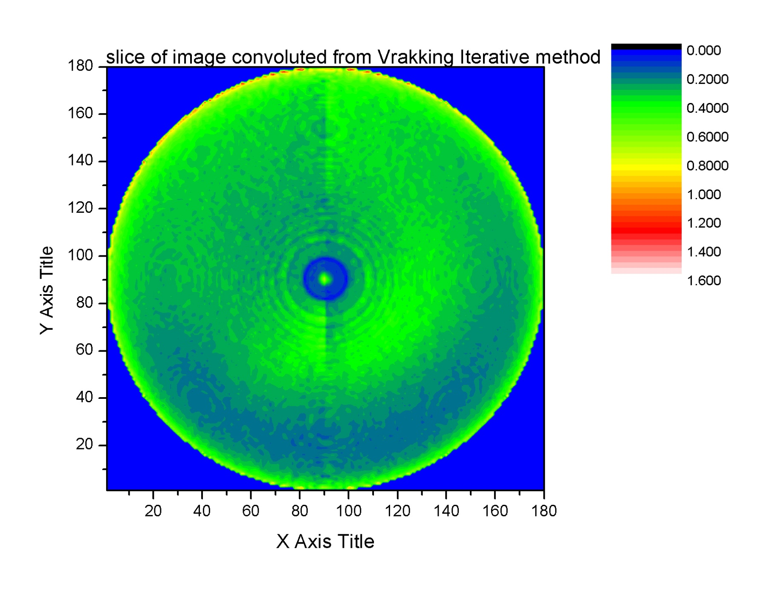
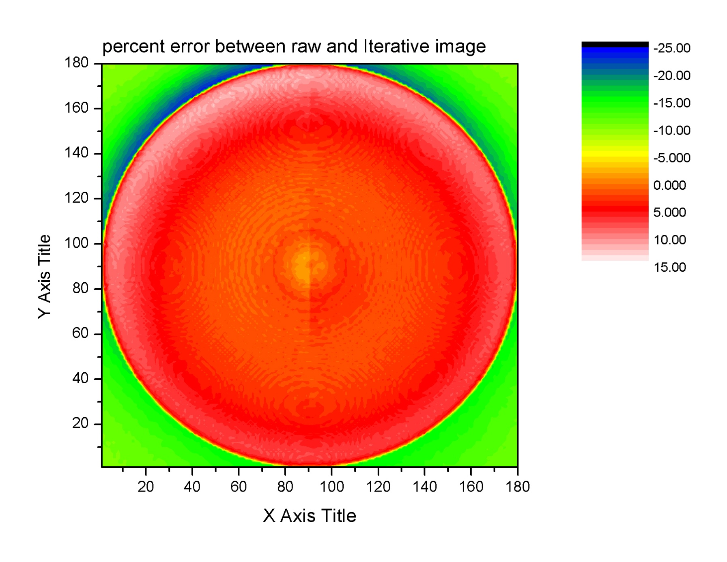
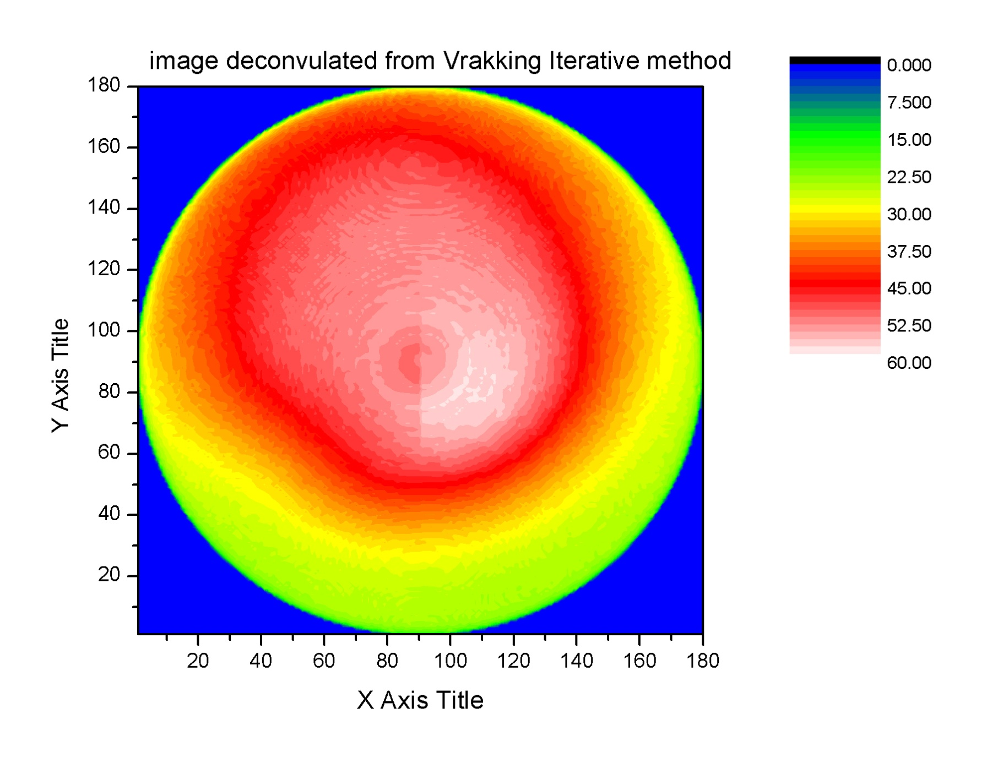
Vrakking iterative method
invert
deconstruct
Percent
error
Notes:
The second option is Vrakking. Vrakking’s method also inverts, but here it produces a slice of the inverted projection in the top right. The 3-d image is then deconstructed back into a 2-d plot. Vrakking then compares the deconstruction to the raw image and does the process again to improve the image. It does this over and over several times. A percent error graph is produced to show the difference between the deconstruction and the raw image. The graph ranges from -25% to 15% error but for the most part is within 5% error. Vrakking does all this in its one program and subprograms and reiterates the inverting and deconstruction to get as close to an even 0% as possible. Looking at the deconstruction, it looks a lot more similar to the raw; it seems that Vrakking assumes no symmetry about x and y. of course, z is symmetric from properties of MOT.

Slide 8
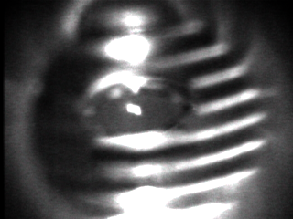
Camera Calibration
Spatial:
compare distance
between plates to
distance in pixels
Notes:
(point out what the plates are, and maybe the MOT in the picture)During these pictures above, the camera is placed at a distance of 7 cm from the viewing port of the MOT chamber. With knowledge that the plates are 4mm wide edge to edge, I measured how many pixels wide the plates were. With the camera at this certain distance from the viewing port, it shows about 85 pixels/mm. Therefore the MOT is about 2 mm in diameter. Pretty big

Slide 9
Camera calibration
Intensity calibration
neutral
density
filter
(ND3.0)
Diverging lens
power meter
iris
laser
camera
Notes:
Secondly, I calibrated the camera to see the intensity relation. To see how the intensity of the laser compares with the values within the pixels of the matrix created and how the gain and shutter speed also affects the pixel values, this setup was made. A beam is through a diverging lens, so naturally it diverges and covers a larger area. The beam then after a long time, encounters an iris where only the maximum of the Gaussian curve goes through the iris; leaving the top of the beam essentially like a platuea. We do this so that there is essentially a definite ring that the camera sees, so that it’s not there then suddenly there with a constant intensity, then gone again. The beam then is attenuated with ND so that the camera isn’t completely saturated. Then I compare the power measured with the gain, shutter speed used and the pixel value observed

Slide 10
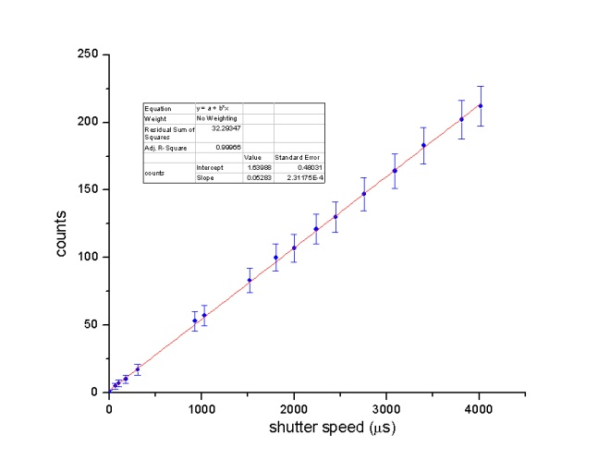
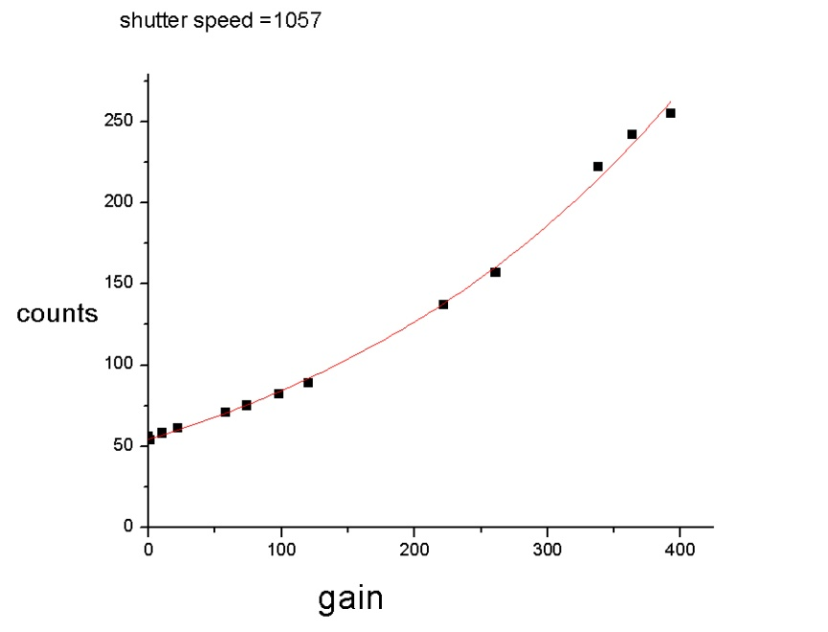
Camera calibration
Shutter speed linear
Gain function is exponential
Notes:
Continuing this setup for a consistently intense beam, I remove the power meter from the setup and take several pictures from the camera. In the first graph I keep a constant gain, brightness and change the shutter speed for several values. Plotting the shutter speed vs pixel value from picture matrixes shows linearity in the change of shutter speed to pixel value. Doing the opposite, change gain, shutter speed constant, shows an exponential function for the gain values. The fitted parameters for this function was determined from the graph, and they were used with the power measured to find a constant.

Slide 11
Results
k = 1.16·10¹² counts/nW
From previous work, we know the ratio of
About 10¹⁹ photons/second hitting camera
Notes:
With this knowledge, one may use the constant calculated from the calibration, the shutter speed and gain defined by the user, the attenuation of the lens, and the total sum count of the pixels that is given by the camera picture to determine the power emitted by spontaneous decay within the MOT. Then, using this to find the photons/sec emitted and the density distribution plots from Vrakking, one could find the density of this cloud of trapped Rubidium atoms.

Slide 12
Thanks to Dr. Brett DePaola, Dr. Larry Weaver, Bachana Lomsadze, Hyounuk Jang, Vince Needham, Kristan Corwin, Kansas State University, and the National Science Foundation

