Slide 1
Direct and Rescattered Electrons under Ultrafast Laser Pulses
Jackson Diodati
Prof. Chii-Dong Lin & Dr. Isaac Yuen
KSU REU 2023

Slide 2
Introduction
Simulating direct scattering and elastic rescattering of electrons under ultrashort strong laser pulses
Calculating values such as ionization probability, energy of ionized electron, etc.
Goal is to explain the electron energy spectra for rescattered electrons

Slide 3
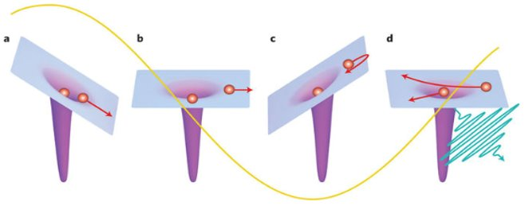
What are Direct and Rescattered Electrons?
3-Step Process:
Initial Ionization of Electron (Direct process ends here)
Change of e-field direction leads to electron acceleration
Electron is “rescattered” again after passing through atom
Midorikawa, Nat. Phot. 5, 640 (2011)

Slide 4
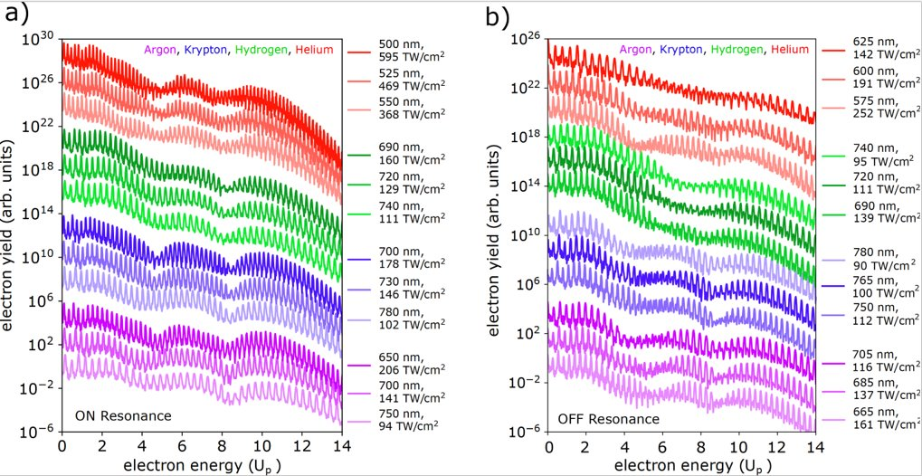

Photoelectron Spectra
$$E_{k}=Nℏω−U_{p}−IP$$
C. Blaga, Kansas State University AMO Seminar, November 2022

Slide 5


Modelling of Electron Wavefunction
Numerov Method to calculate stationary states under atomic soft-core potential
  $V\left(x\right)=\frac{−1}{\sqrt{x^{2}+a^{2}}}$
Crank-Nicolson Method to propagate wavefunction over time with TDSE:
  $−iℏ\frac{∂ψ}{∂t}=\hat{H}ψ$
$$\left(1+\frac{iτ}{ℏ}{\hat{H}}_{i+1}\right)ψ_{i+1}=\left(1−\frac{iτ}{ℏ}{\hat{H}}_{i}\right)ψ_{i}$$
B. R. Johnson; J. Chem. Phys. (1977).
https://github.com/aychun/Crank-Nicolson-Method-for-Time-Dependent-Schrodinger-Equation

Slide 6
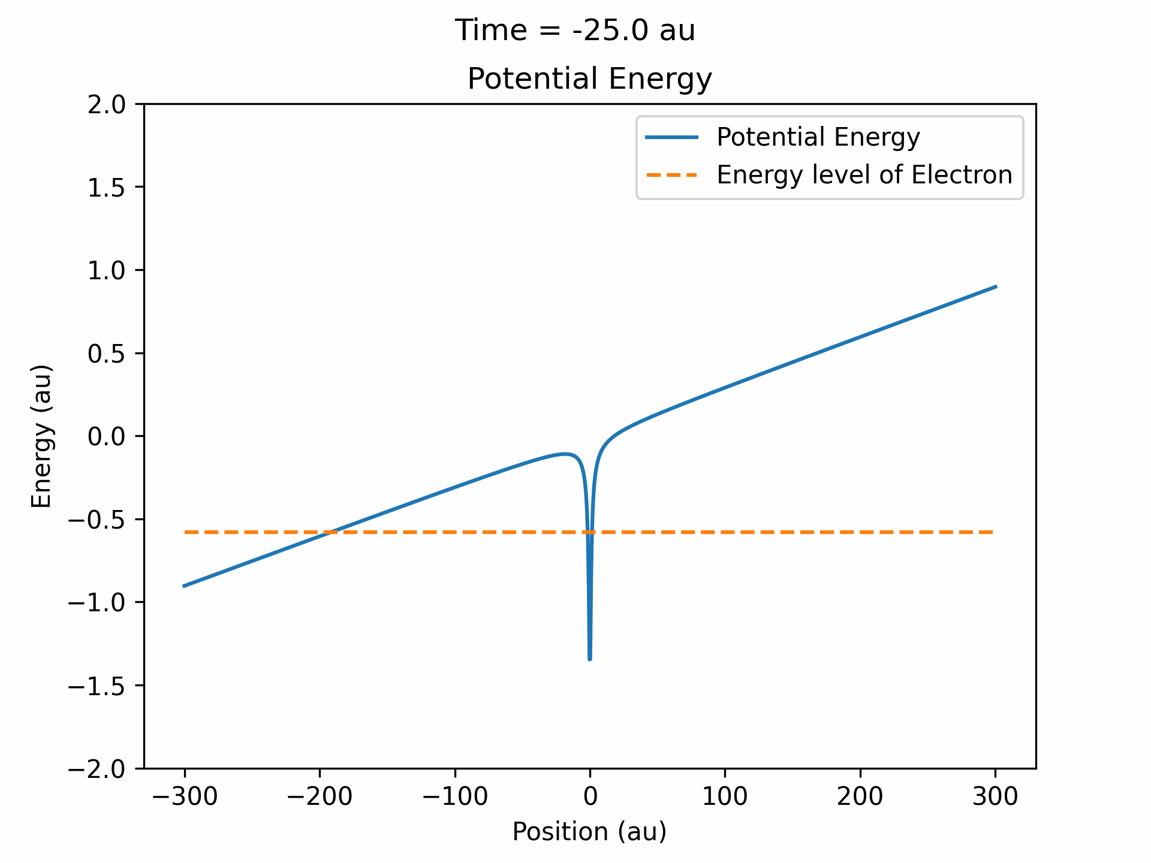
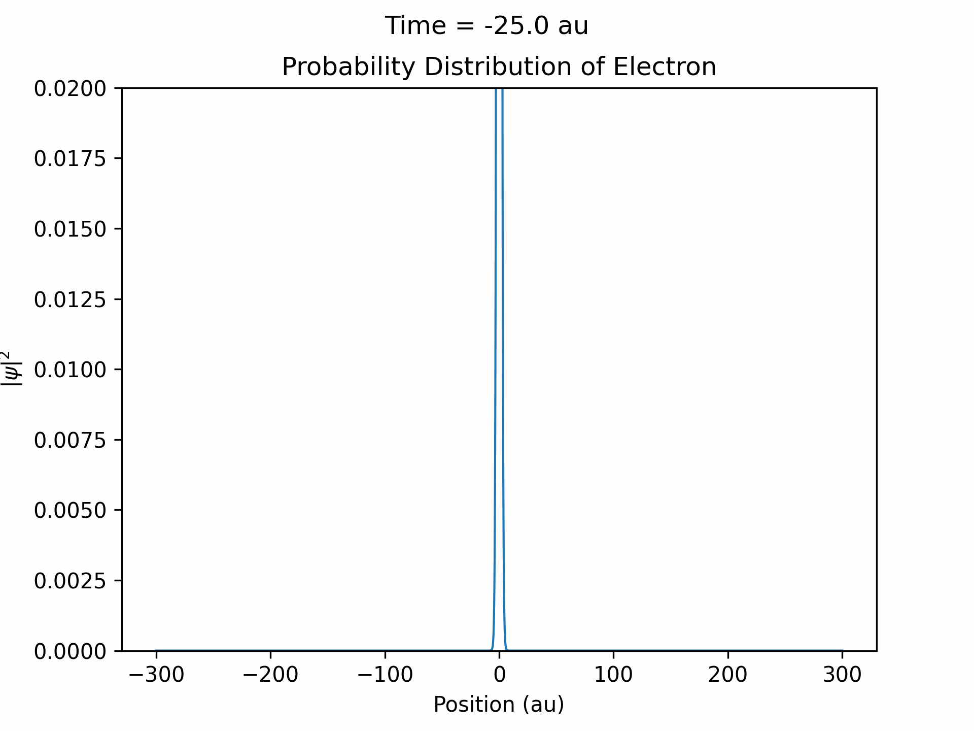
Constant Field Ionization
100 TW/cm^2 Constant Laser at Argon

Slide 7
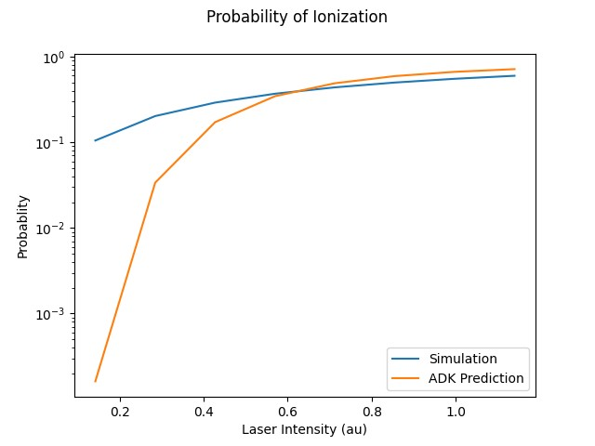
Probability of Ionization
Can calculate probability through finding area of ionized wavepacket
Compare to Ammosov-Delone-Krainov Theory
Laser at Ground State Electron in Helium Atom

Slide 8
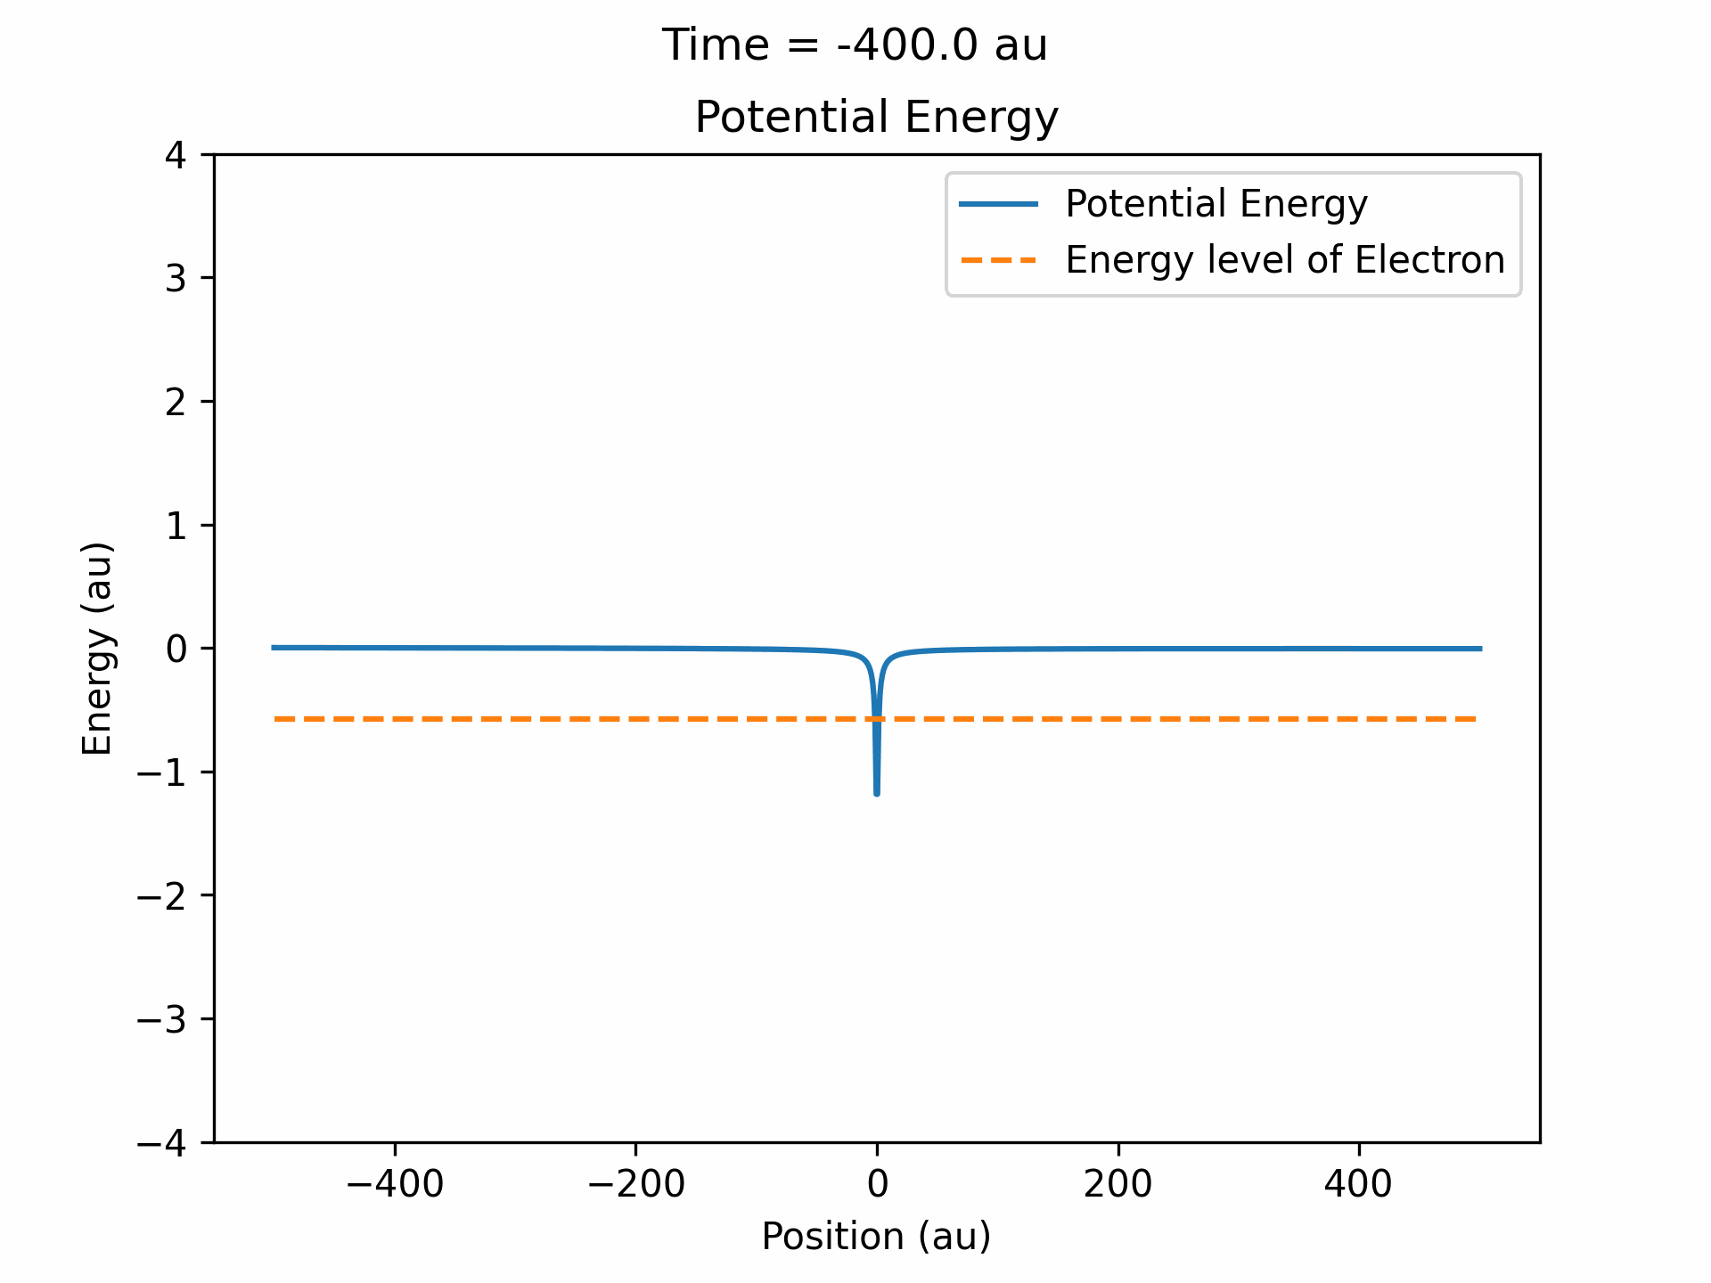
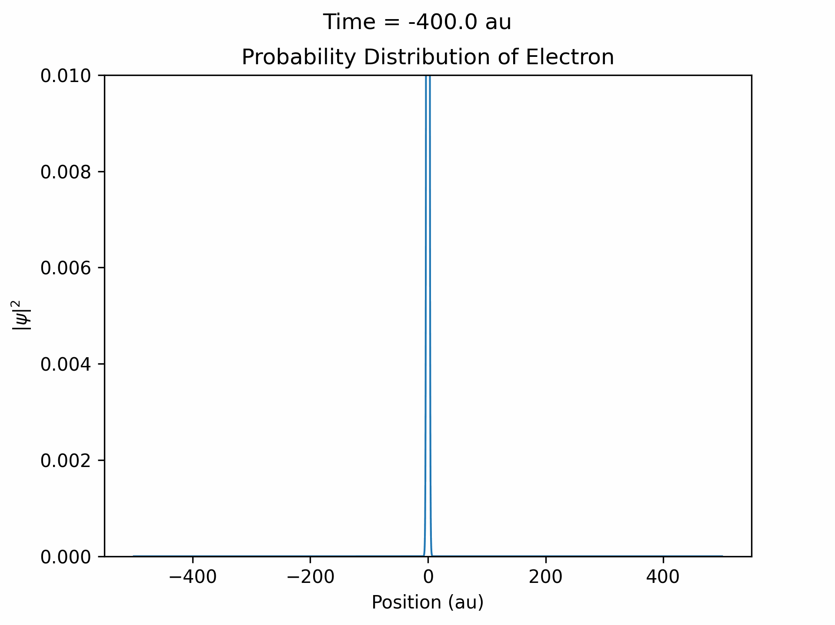
Ionization from Laser Pulse
150 TW/cm^2 Laser @ 800 nm at Ground State Electron in Argon

Slide 9
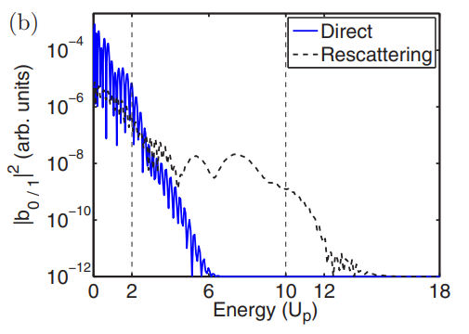
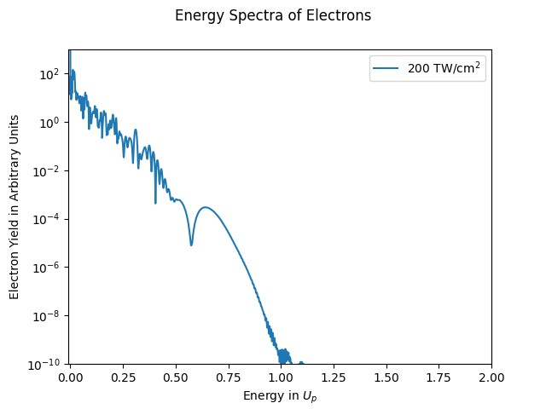
Energy Spectra of Emitted Electron
Suarez, N., et al. Phys. Rev. A. (2015)

Slide 10


Thank you to…
Prof. Loren Greenman, Prof. J.T., and Kim Coy
Prof. Chii-Dong Lin and Dr. Isaac Yuen
Kansas State University
National Science Foundation
You for listening!
This material is based upon work supported by the National Science Foundation under Grant No. #2244539. Any opinions, findings, and conclusions or recommendations expressed in this material are those of the author(s) and do not necessarily reflect the views of the National Science Foundation.

Slide 11
Questions?
How do you determine Soft-Core Coloumb Potential constant?
Why does the simulation not start at t = 0?
What is the energy parameter U_{p}?

